Slide 1
PRETERM LABOUR
Dr.Sheeba .S MD (Hom)
Assistant Professor
Dept. of OBG
SKHMC

Slide 2
DEFINITION
ETIOLOGY
MANAGEMENT
CONTENTS
PREVENTION
MEASURES TO ARREST PTB

Slide 3
DEFINITION: Preterm labor (PTL) is defined as one where the labor starts before the 37th completed week (< 259 days), counting from the first day of the last menstrual period
INCIDENCE: The prevalence widely varies and ranges between 5% and 10%
Preterm birth is the significant cause of perinatal morbidity and mortality

Slide 4
DEFINITION:
Preterm labor (PTL) is defined as one where the labor starts before the 37th completed week (< 259 days), counting from the first day of the last menstrual period. The lower limit of gestation is not uniformly defined; whereas in developed countries it has been brought down to 20 weeks, in developing countries it is 28 weeks.

Slide 5
CLASSIFICATIONS OF PRETERM LABOUR
Term 39-40 weeks 6 days
Early term -37-39 weeks
Late preterm birth-34-37 weeks
Very late preterm birth-28- 32 weeks
Extremely late preterm birth-28 weeks
v

Slide 6
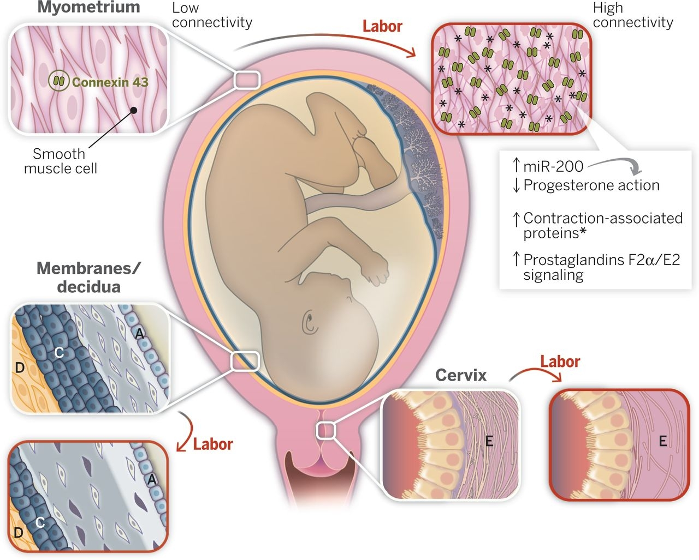
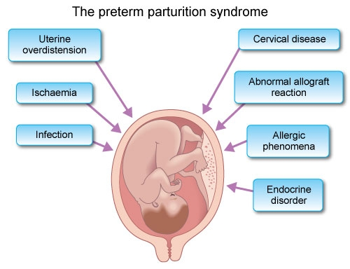

Slide 7
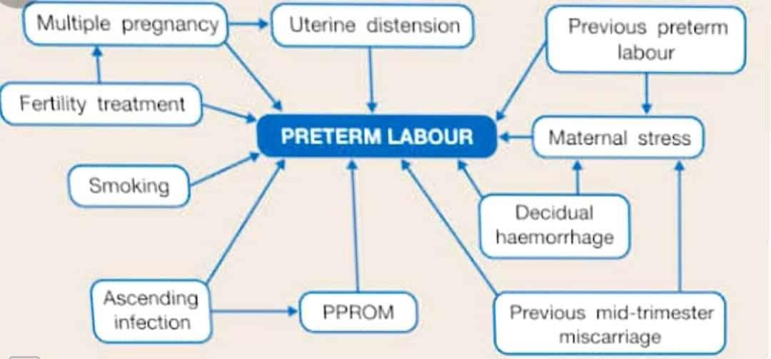
FACTORS ASSOCIATED WITH PRETERM LABOUR

Slide 8
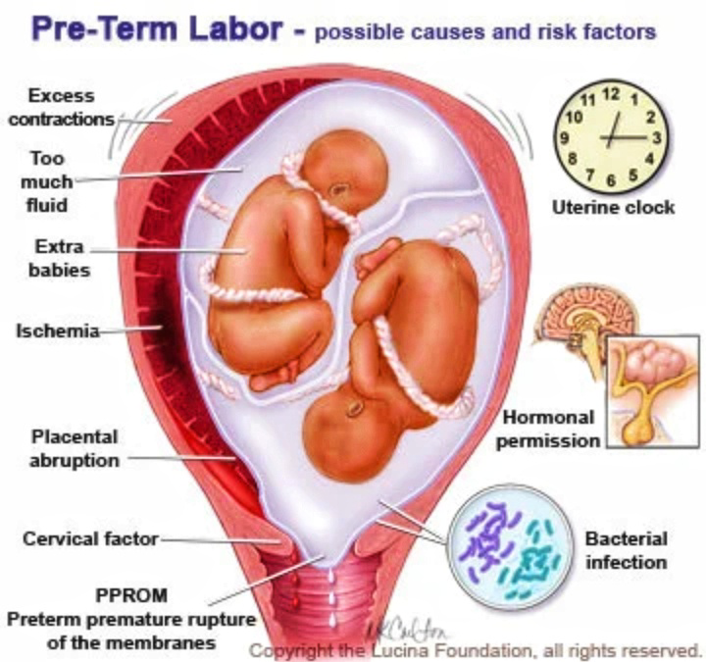
CAUSES AND RISK FACTORS

Slide 9
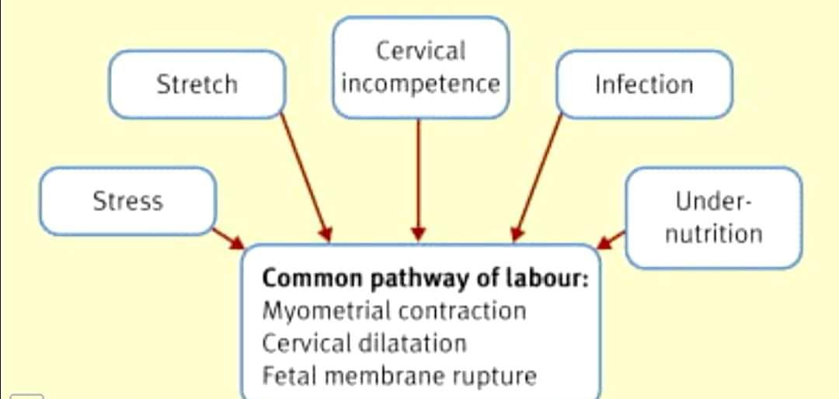
MECHANISM OF PRETERM LABOUR

Slide 11
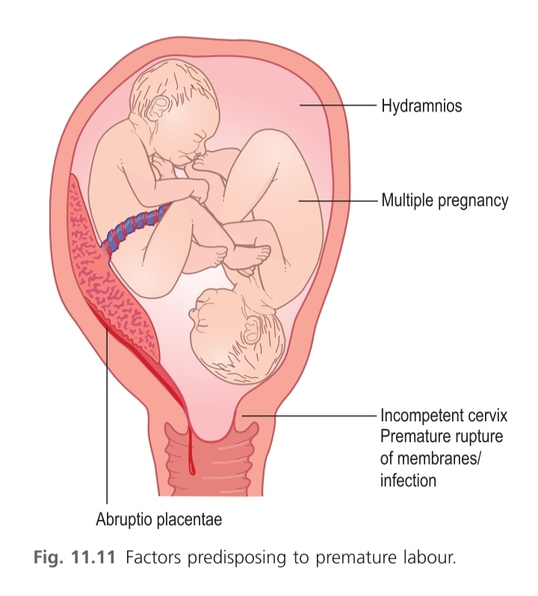
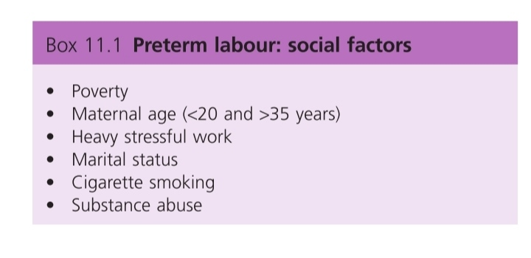

Slide 13
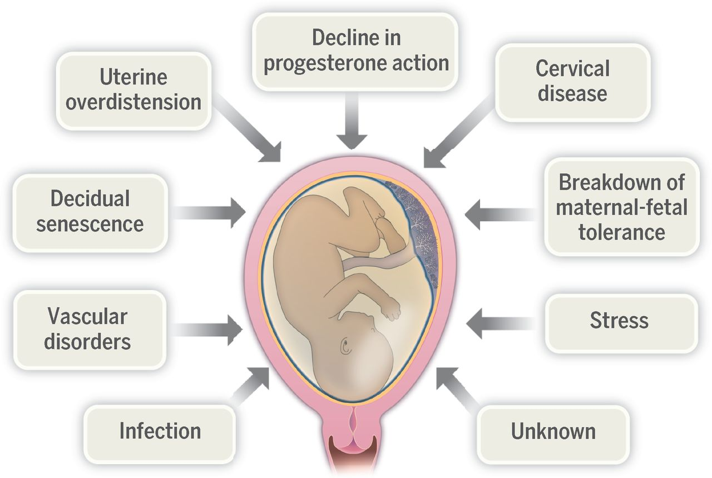
ETIOLOGY

Slide 15
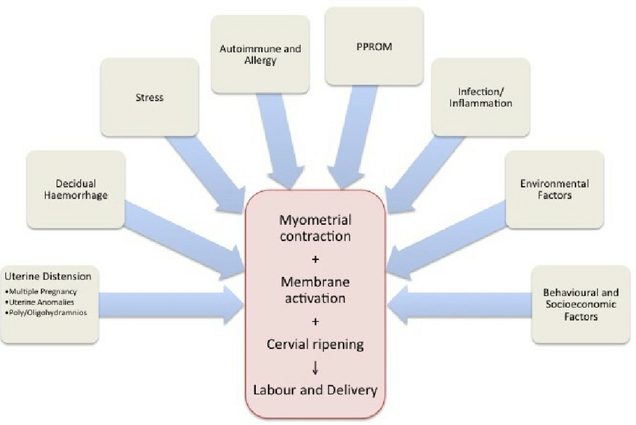
ETIOLOGY

Slide 16
IATROGENIC
HISTORY
ETIOLOGY
COMPLICATIONS IN PRESENTPREGNANCY
IDIOPATHIC

Slide 17
ETIOLOGY
IATROGENIC:
Indicated preterm delivery due to medical or obstetric complications.
IDIOPATHIC: (Majority)
Premature effacement of the cervix with irritable uterus and early engagement of the head are often associated. In the absence of any complicating factors, it is presumed that there is premature activation of the same systems involved in initiating labor at term.

Slide 18
HISTORY
Previous history of induced or spontaneous abortion or preterm delivery;
Pregnancy following assisted reproductive techniques (ART);
Asymptomatic bacteriuria or recurrent urinary tract infection;
Smoking habits
Low socioeconomic and nutritional status and
Maternal stress.

Slide 19
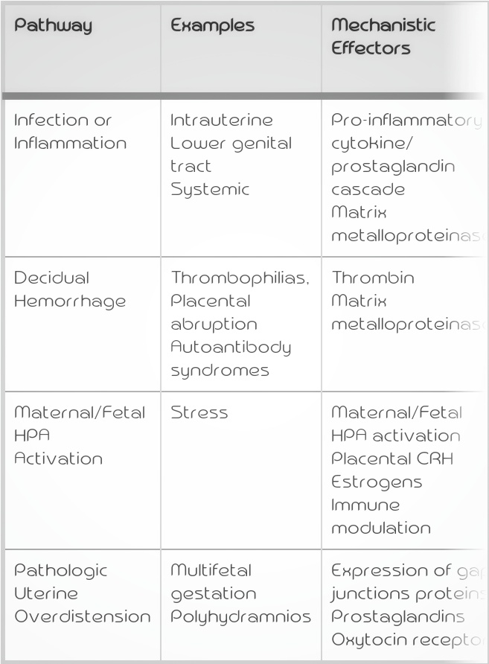
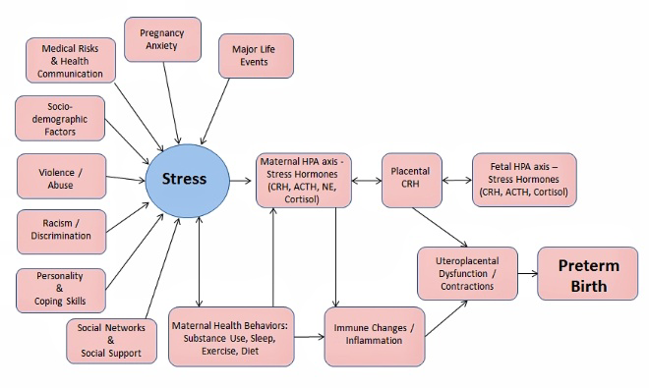
ETIOLOGY AND PATHWAYS LEADS TO SPONTANEOUS PRETERM BIRTH

Slide 21
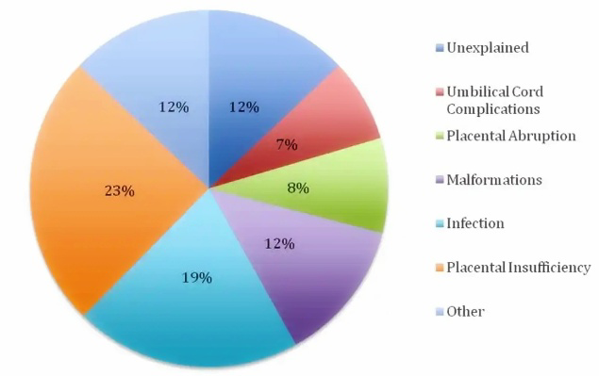

Slide 22
PATHOGENESIS

Slide 24
HIGH RISK FACTORS
A) HISTORY: *Previous history of induced or spontaneous or preterm delivery *pregnancy following assisted reproductive techniques *asymptomatic bacteriuria *recurrent urinary tract infection *smoking Low socioeconomic and nutritional status. Maternal stress.
B)IATROGENIC: Indicated preterm delivery due to medical or obstetrical complications
C) IDIOPATHIC: *Premature effacement of cervix *Irritable uterus *Early engagement of head *Premature activation of labor initiating systems

Slide 25
PSYCHOSOCIAL FACTORS
Anxiety
Stress
Depression
Negative life events
Perception of racial discrimination and domestic violence
Excessive alchohol intake
amoking
PAST OBSTETRIC HISTORY
Previous h/o preterm birth or second trimester pregnancy loss
3 or more abortion(may result in cervical incompetence)
Conceptions following in-vitro fertilization

Slide 26
INFECTION
Asymptomatic bacterial vaginosis
Trichomonas vaginalis
Chlamydia trachomatis
Ureaplasma urealyticum
Mycoplasm hominis
Asymptomatic bacteriuria
Systematic infections like-pyelonephritis,pneumonia,acute appendicitis
GENETIC
Single gene polymorphisms of cytokines in boyh mother and fetus may be responsible.
Polymorphism involving TNFα-308,IL-1ß and IL-6 have been most consistently associated with spontaneous preterm labour.irth.

Slide 27
SYMPTOMS

Slide 28
SIGNS
Palpable uterine contraction
Enlargement of presenting part
Cervical effacement & dilatation
Show( may be blood stained)
Bulging membrane
Rupture of membranes

Slide 29
CLINICAL FEATURES AND EXAMINATION

Slide 30
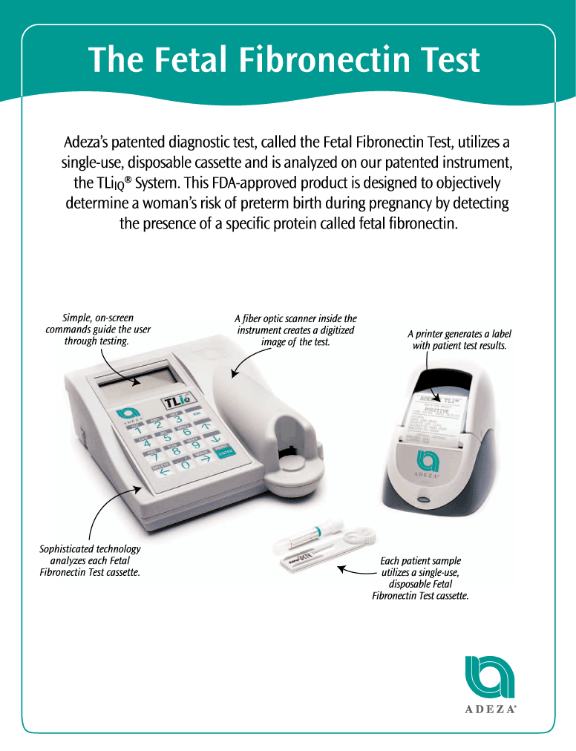
INVESTIGATIONS *Full blood count *Urine for analysis,culture, and sensitivity *Cervicovaginal swab for culture and fibronectin *Ultrasonography *Serum electrolytes and glucose levels when tocolytic agents are given.

Slide 31
DIAGNOSIS
Regular uterine contractions with or without pain (at least one in every 10 minutes)
Dilatation (> 2 cm)
Effacement (80%) of the cervix
MANAGEMENT OF PRETERM LABOR
(1) To prevent preterm onset of labor, if possible.
(2) To arrest preterm labor,if not contraindicated.
(3) Appropriate management of labour
(4) Effective neonatal care.

Slide 32
PRINCIPLES OF MANAGEMENT OF WOMEN WITH PRETERM LABOR
GLUCOCORTICOIDS | GIVEN TO MOTHER TO REDUCE NEONATAL COMPLICATIONS
ANTENATAL TRANSFER | Antenatal transfer of the mother with fetus in utero to a tertiary centre equipped with Neonatal Intensive Care Unit(NICU)
TOCOLYTIC DRUGS | Given to mother for a short period unless contraindicated
ANTIBIOTICS | Given to prevent neonatal infection with Group B streptococcus
MAGNESIUM SULPHATE | Given to the mother to reduce neonatal cerebral palsy when pregnancy is <34 weeks
CAREFUL INTRAPARTUM MONITORING | Presence of a neonatologist during delivery. Ensure minimal trauma
VAGINAL DELIVERY | Is prefered unless otherwise indicated for cesarian birth.

Slide 33
MANAGEMENT IN LABOR
FIRST STAGE | SECOND STAGE
Bed rest to prevent early rupture of the membranes | Birth should be slow and gentle to avoid rapid compression and decomposition of head
To ensure adequate fetal oxygenation by giving oxygen to mother by mask. | Episiotomy done to minimize head compression if there is perineal resistance.
Epidural analgesia is of choice | Tendancy to delay is curtailed by low forceps
Labor should be carefully monitored perferably with continous Electronic fetal heart monitoring | The cord is to be clamped immediately at birth to prevent hypervolumia and hyperbilirubinemia
Cesarian delivery only when indicated | To shift the baby to the neonatal intensive care unit under the care of the neonatologist.
NICU(Neonatal intensive care unit)

Slide 35
COMPLICATIONS IN PRESENTPREGNANCY
MATERNAL
Pregnancy complications: Preeclampsia, antepartum hemorrhage, premature rupture of the membranes, polyhydramnios
Uterine anomalies: Cervical incompetence, malformation of uterus;
Chronic diseases: Hypertension, nephritis, diabetes, decompensated heart lesion, severe anemia, low body mass index (LBMI);
Genital tract infection: Bacterial vaginosis, beta-hemolytic Streptococcus, bacteroides, chlamydia and mycoplasma.

Slide 36
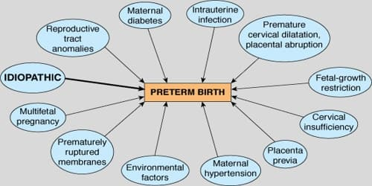
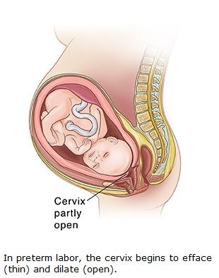
FETAL:
Multiple pregnancy, congenital malformations and intrauterine death. 
PLACENTAL:
Infarction, thrombosis, placenta previa or abruption.

Slide 37
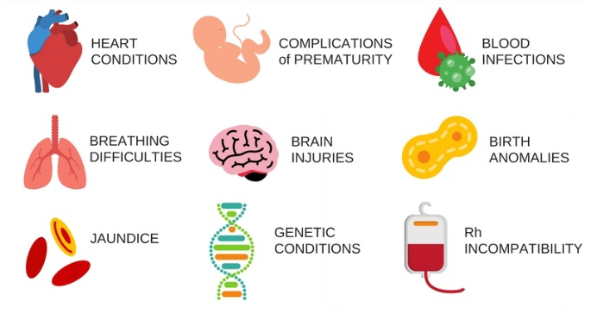
COMPLICATIONS

Slide 38
COMPLICATIONS

Slide 39
CONTRAINDICATIONS
Gestation> 34 weeks & Labour is too advanced
Utero Fetal death
Maternal hypotension :BP<90mm Hg systolic
Pre-eclampsia
Multiple pregnancy
Placental praevia

Slide 40
MANAGEMENT

Slide 44
Investigations
Full blood count
Urine for routine analysis, culture and sensitivity
Cervicovaginal swab for culture and fibronectin
Ultrasonography for fetal well being, cervical length and placental localization
Serum electrolytes and glucose levels when tocolytic agents are to be used

Slide 45
PREVENTION OF PRETERM LABOUR
Primary care is aimed to reduce the incidence of preterm labor by reducing the high-risk factors
Secondary care includes screening tests for early detection and prophylactic treatment
Tertiary care is aimed to reduce the perinatal morbidity and mortality after the diagnosis

Slide 46
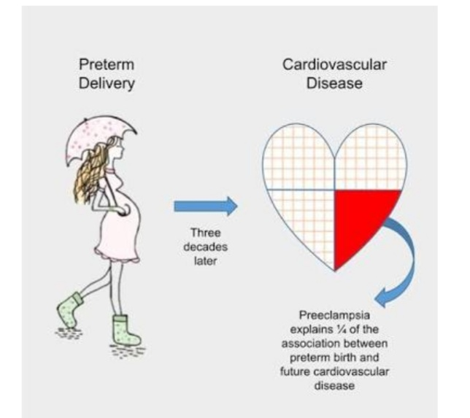

Slide 47
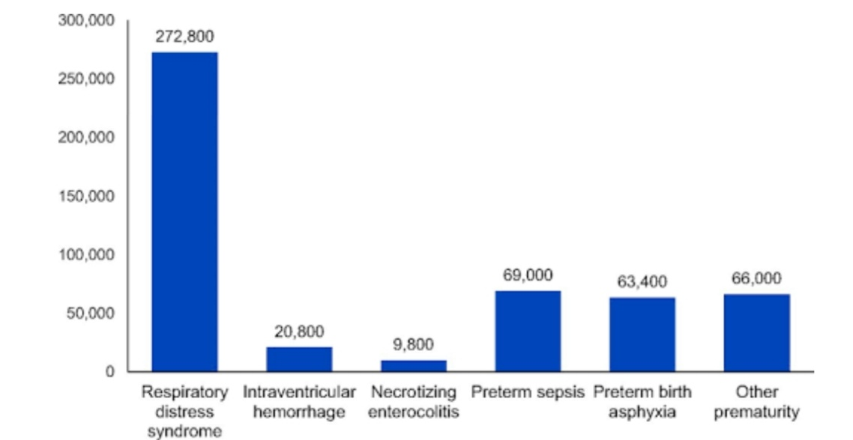

Slide 48
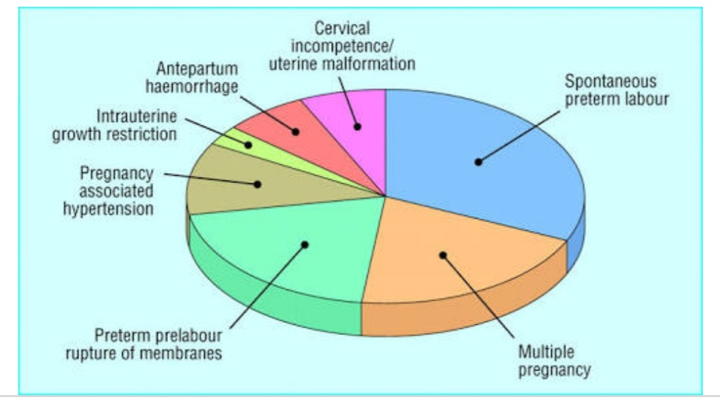
Cause

Slide 49
prevention
Primary care
To reduce the incidence by reducing the high risk factors
Eg: infection
Secondary care
Screening test for early detection
Prophylactic treatment
Tertiary care
To reduce prenatal
Mortality after the diagnosis
Morbidity

Slide 50
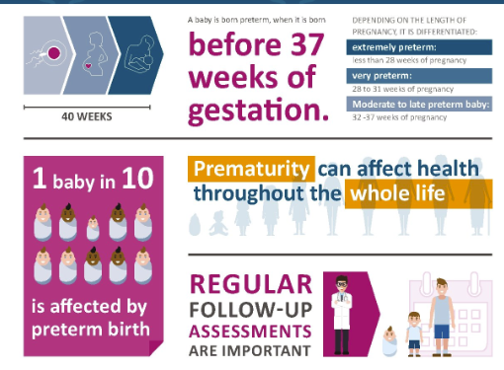

Slide 51
MANAGEMENT oF PRETERM LAboR
To prevent preterm onset of labor, if possible
Appropriate management of labor;
Effective neonatal care.
To arrest preterm labor if not contraindicated

Slide 52
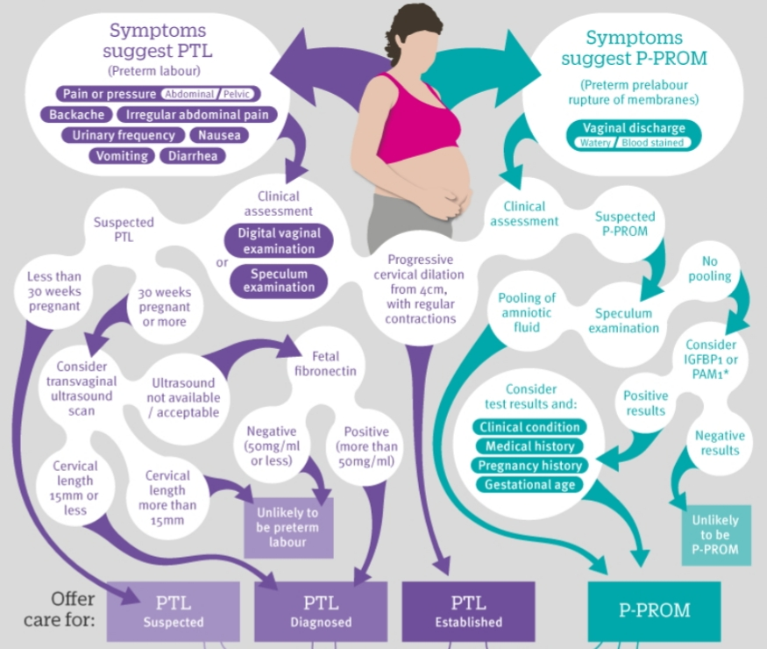

Slide 53
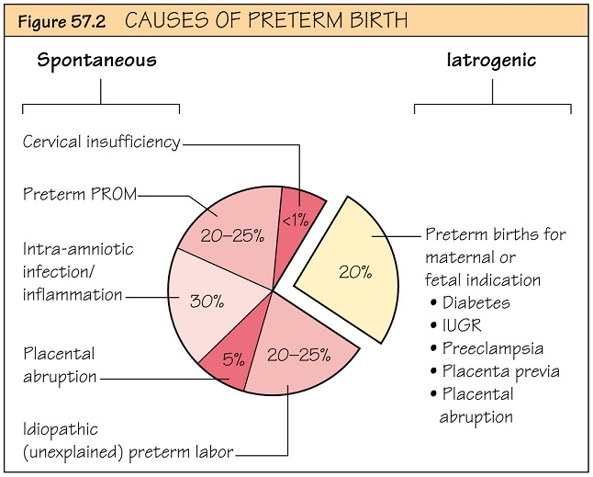

Slide 54
Management

Slide 55
MANAGEMENT

Slide 56
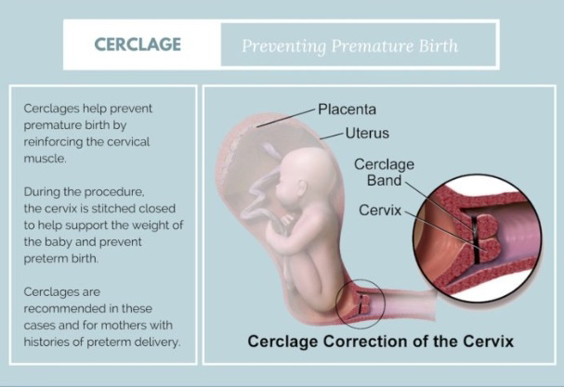

Slide 57
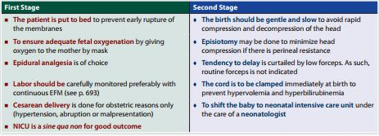
MANAGEMENT IN LABOR:
Principle:
To prevent birth asphyxia and development of RDS
To prevent birth trauma .

Slide 58
PRINCIPLES IN MANAGEMENT OF PRETERM LABOR

Slide 59
Eat a healthy diet. Healthy pregnancy outcomes are generally associated with good nutrition. In addition, some research suggests that a diet high in polyunsaturated fatty acids (PUFAs) is associated with a lower risk of premature birth. PUFAs are found in nuts, seeds, fish and seed oils.

Slide 60
Avoid risky substances. If you smoke, quit. Ask your health care provider about a smoking cessation program. Illicit drugs are off-limits, too.
Consider pregnancy spacing. Some research suggests a link between pregnancies spaced less than six months apart, or more than 59 months apart, and an increased risk of premature birth. Consider talking to your health care provider about pregnancy spacing.

Slide 61
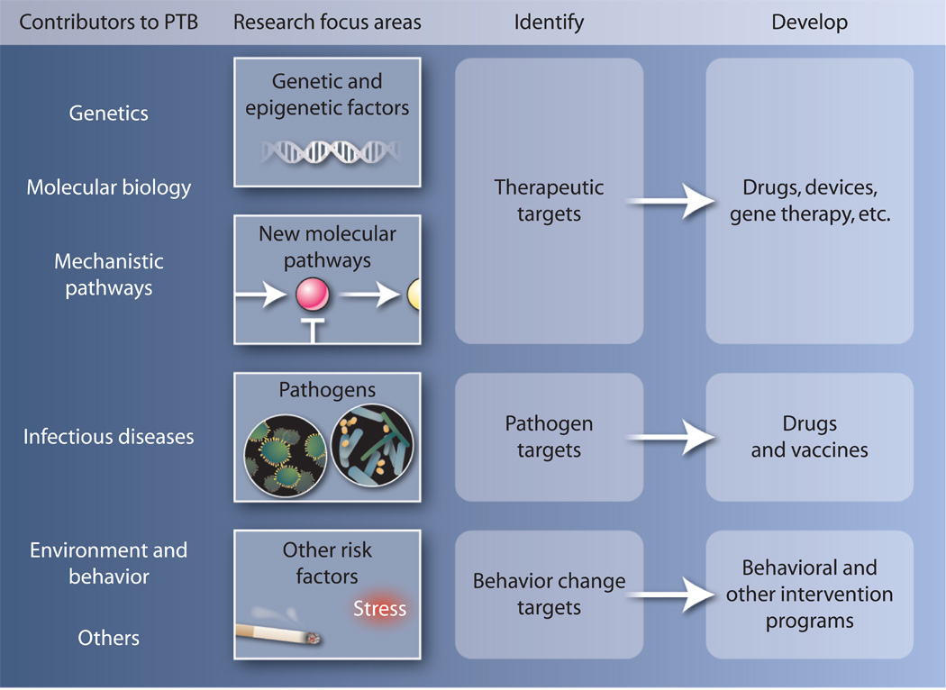
PREVENTION

Slide 62
MEASURES TO ARREST PRETERM LABOUR
Bed rest in left lateral position
Adequate hydration
Glucocorticoids
Prophylactic Cervical circlage (in some cases)
Tocolytics

Slide 63
Predictors of preterm labor
Clinical predictors: (i) History of prior preterm birth; (ii) Multiple
pregnancy; (iii) Presence of genital tract infection; (iv) Symptoms of PTL
Biochemical predictors: (i) Fetal fibronectin (fFN) in cervicovaginal discharge (see below) (ii) Others IL-6, IL-8, TNF-α.
Biophysical predictors: (i) Uterine contractions (UC) > 4/hr; (ii) Bishop score > 4; (iii) Cervical length (TVS) < 25 mm.

Slide 64
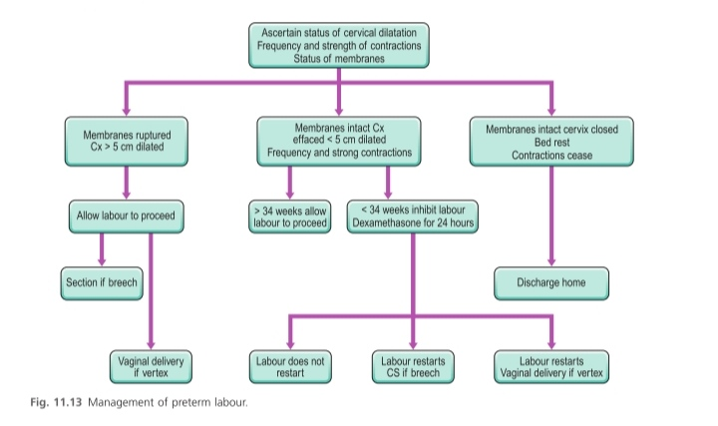
Management flowchart

Slide 65
Predictors of preterm labor
A. CLINICAL PREDICTORS | H/O prior preterm birth Multiple pregnancy Presence of genital tract infection
B. BIOPHYSICAL PREDICTORS | Uterine contractions >4/hr Bishop score>4 Cervical length <25mm
C.BIOCHEMICAL PREDICTORS | Fetal fibronectin in cervicovaginal discharge IL-6,IL-8,TNF-alpha in cervicovaginal discharge

Slide 66
PREVENTIoN oF PRETERM LAboR
Primary care is aimed to reduce the incidence of preterm labor by reducing the high-risk factors (e.g. infection, etc.).  Secondary care includes screening tests for early detection and prophylactic treatment (e.g. tocolytics).  Tertiary care is aimed to reduce the perinatal morbidity and mortality after the diagnosis (e.g. use of corticosteroids).

Slide 67
MEASURES To Arrest Preterm Labor
Bed rest—The patient is to lie preferably in left lateral position though the benefits are doubtful.
⧫ Adequate hydration is maintained. Prophylactic antibiotic is not routinely given. It is recommended when infection is evident or culture report suggests.
⧫ Prophylactic cervical cerclage -for women with prior preterm birth and short cervix in the present pregnancy may be beneficial.
⧫ Tocolytic agents: Various drugs nifedipine, atosiban, progesterone (micronized) have been used to inhibit uterine contractions. Drugs that can be used are described in Chapter 34. The tocolytic agents can be used as short-term (1–3 days) or long-term therapy. Tocolytics should preferably be avoided as there is no clear benefit (RCOG–2002).
⧫ Dose schedule of MgSO4 and monitoring are same as used for seizure prophylaxis of preeclampsia (4 g IV over 3–5 minutes followed by an infusion of 1 g/hr).

Slide 68
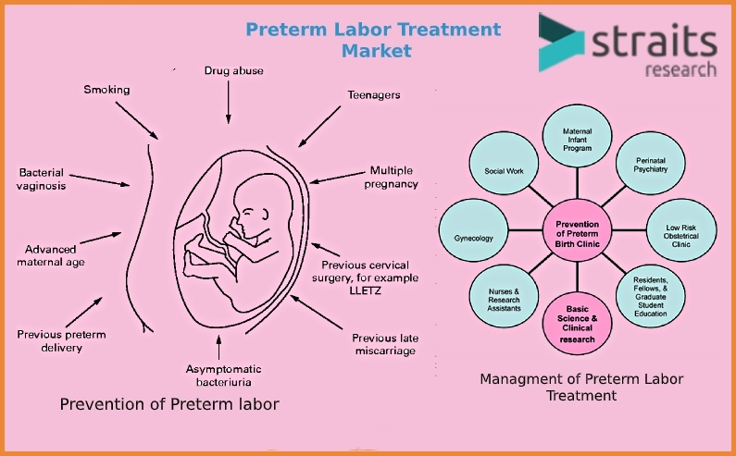

Slide 69
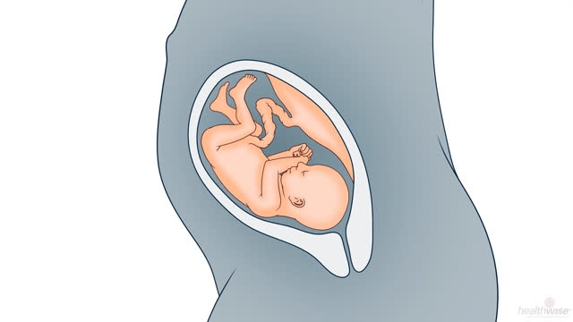
Short-term therapy
The objectives are:
(1) To delay delivery for at least 48 hours for glucocorticoid therapy to the mother to enhance fetal lung maturation and
(2) In utero transfer of the patient to a unit with an advanced neonatal intensive care unit (NICU)

Slide 70
Short-term therapy
: Contraindications are — A. Maternal: Uncontrolled diabetes, thyrotoxicosis, severe hypertension, cardiac disease, hemorrhage in pregnancy, e.g. placenta previa or abruption. B. Fetal: Fetal distress, fetal death, congenital malformation and pregnancy beyond 34 weeks. C. Others: Rupture of membranes, chorioamnionitis and cervical dilatation more than 4 cm.

Slide 71
Homoeopathic therapeutics:
Chamomilla:
Preliminary or premature pains beginning in the back and following the sacral and ischiatic plexuses down the thighs.

Slide 72
Kali-carbonicum (Kali-c) – Irregular contractions. Pain of contractions felt mainly in the back Feels as if back may break, much better for firm pressure. Fearful of dying.

Slide 73
HOMOEOPATHY REMEDIES FOR PREMATURE LABOUR
CARBO VEGETABILIS- clinical hypoxia: difficult birth, laborious start of the breathing : C section, neonatal revival, oxygen therapy during the first hours of the life and later recurrent hypoxia and hypercapnia events, flu degenerating into asthma,bronchiolitis especially in a polluted or full of cigarette smoke atmosphere.
OPIUM- it can avoid the premature delivery of the baby.
BOVISTA- remedy to give in case of neonatal jaundice

Slide 74
PREDECTION OF PRETERM LABOUR
FETAL FIBRONECTIN
It is a glycoproteinthat binds the Fetal membrane to the decidua
It is found in the cervicovaginal discharge before 22 week & after37 week of pregnancy
Presence of FIBRONECTIN in cervicovaginal discharge between 24&34 week is a predictor of preterm labour

